Slide 1

MKT 6352
Marketing Web Analytics and Insights
Group 08
Gauri Surti | Ishtiaq Omair | Krushita Pradeepbhai Umrigar
Mashiyat Iqbal | Md Raiyan Rahman | Revati Shirish Navgale

Slide 2
Agenda
Company Introduction
Business Objectives
Key Performance Indicators
Revenue
Conversion Rate
Average Order Value
Recommendations
Waterfall Table Analysis

Slide 3

Company: Target
General merchandise retailer with stores in all the US states
Tagline: ‘Expect More. Pay Less.’
A total of 1954 stores in the USA
Teamed up with Apple, Ulta Beauty, Starbucks, Levi, Strauss & Co to create innovative new in-store and digital shopping experiences
There are 45+ owned brands unique to target
5% of Target’s profits go back to the community
Source: https://corporate.target.com

Slide 4

Business Objectives
Increasing Revenue across all geographical locations in the US,
channels and device categories.
Increasing the percentage of website visitors who will make more purchases and enhance overall business growth.
Increasing Average Order Value across different states in the US and across all visitors that come into our website.
Source: https://corporate.target.com

Slide 5
Key Performance Indicators
Revenue
Conversion Rate
Average Order Value (AOV)

Slide 6
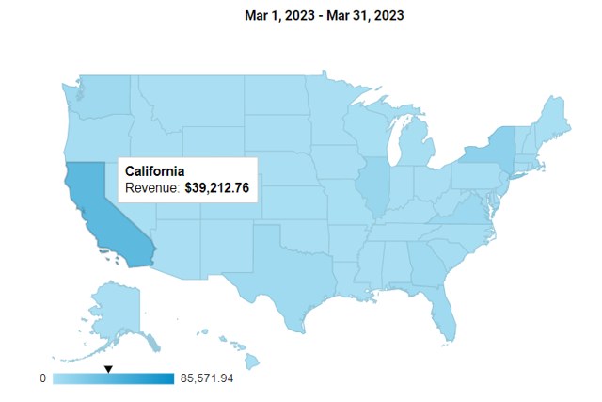
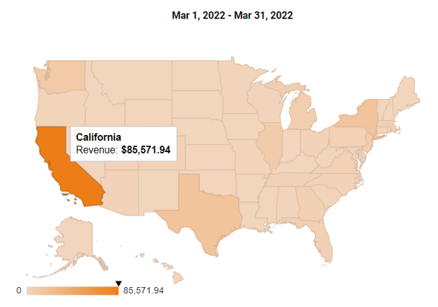
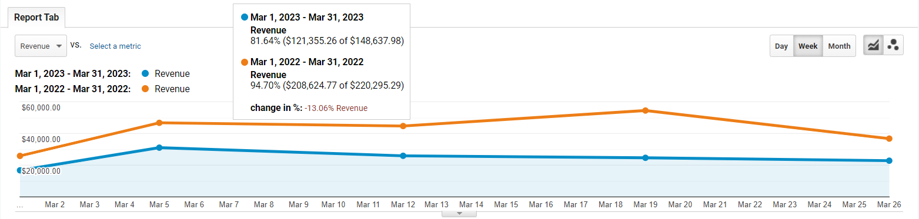
Revenue – Overall Analysis
California has retained its top spot as the state with the highest revenue for the month of March in year 2022 and 2023.
According to the line graph, the United States' overall revenue was around 41% lower in 2023 than it was in 2022 for March.
There was a significant change in revenue difference ratio after a first fortnight and at the conclusion of month, it retained the original ratio.

Slide 7
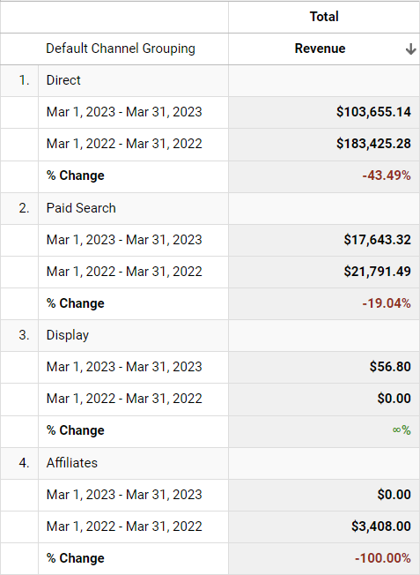
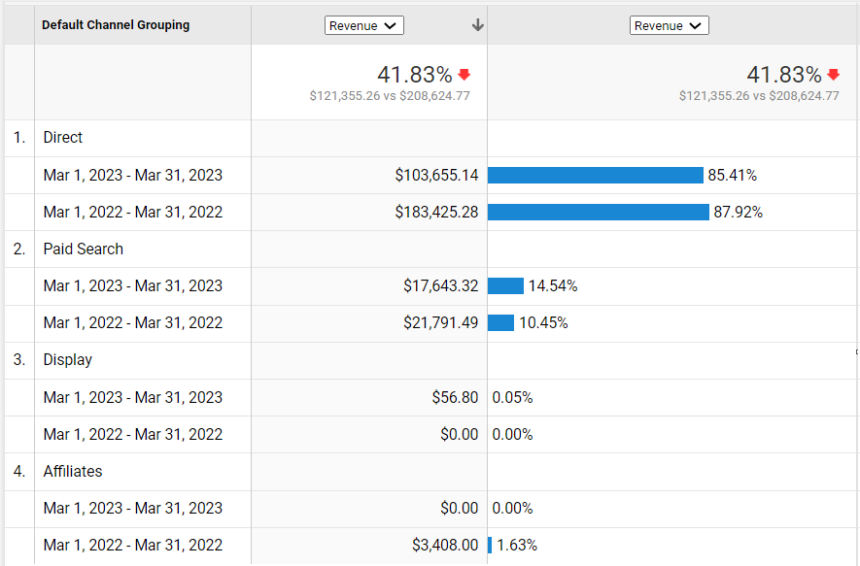
Revenue – Channel Grouping
Direct channel is the primary driver of revenue for the website, as it consistently generates the most revenue in both March 2022 and March 2023
Paid Search generates a smaller portion of the revenue, but it still plays an important role in driving traffic to the website.
Display and Affiliates channels generated minimal revenue in both March 2022 and March 2023. This suggests that the website may not be putting enough resources into these channels.

Slide 8
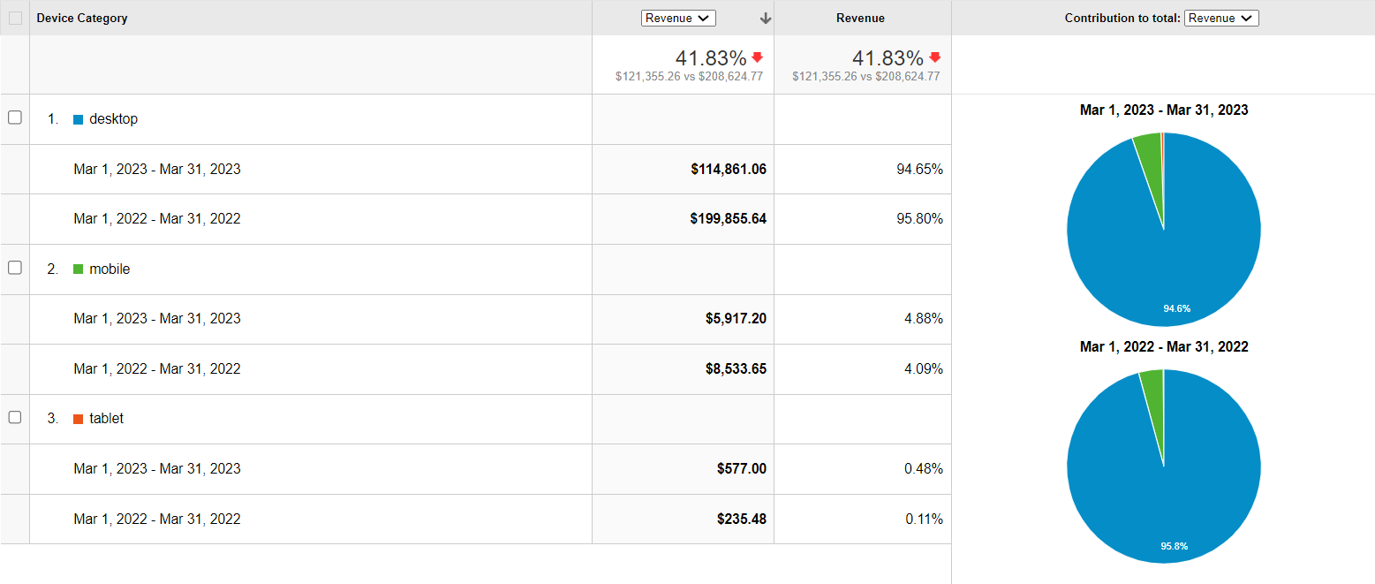
Revenue – Device Category
Revenue from Desktop traffic was much greater for both years than from Mobile and Tablet traffic. It consumed almost 95% of the entire revenue.
Mobile and Tablet traffic dramatically underperformed Desktop in terms of revenue. Especially, Tablet had a negligible income for year 2022 than 2023.

Slide 9
Recommendations
Focus on the Direct channel: It consistently generates the most revenue for the website. By providing these customers with personalized user experiences and incentives to refer their friends, the website can retain them and increase revenue.
Allocate more resources towards improving Paid Search: The website should allocate more resources toward Paid Search to improve its effectiveness. This can be done by optimizing ad copy, bidding strategies, and targeting to reach potential customers.
Optimizing the Display and Affiliate channels: It can increase their revenue potential. The website should focus on targeting relevant audiences, optimizing ad placements, and improving the user experience to increase engagement and revenue from these channels.
Invest in improving the website's mobile and tablet experience: Optimizing the website's design and functionality for smaller screens, improving page load speed, and ensuring a smooth user experience to increase revenue from these channels.

Slide 10
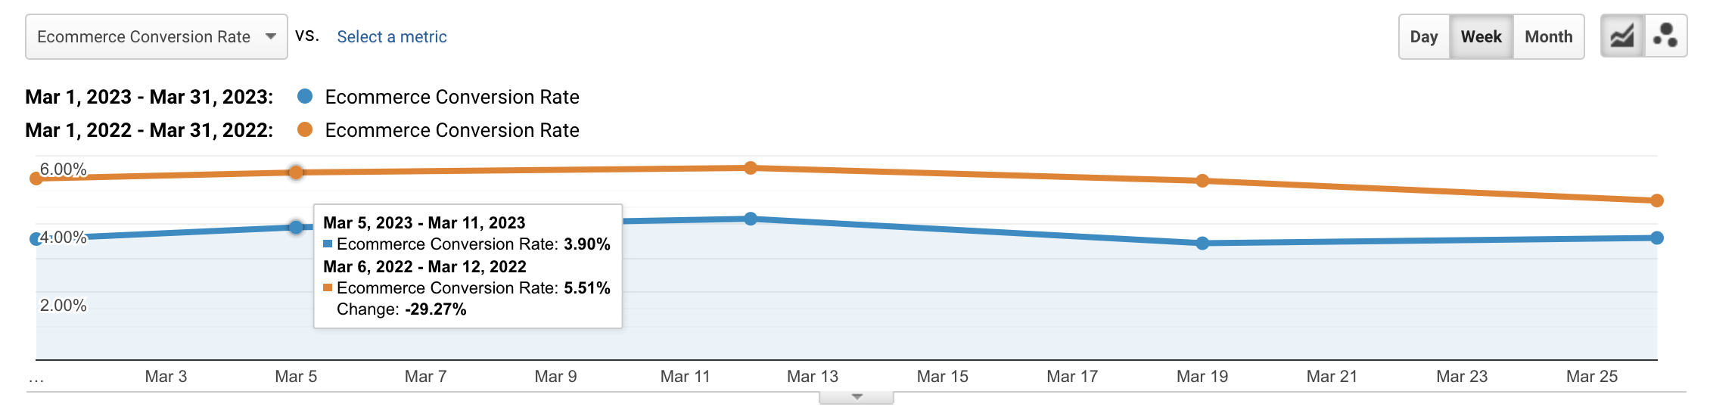
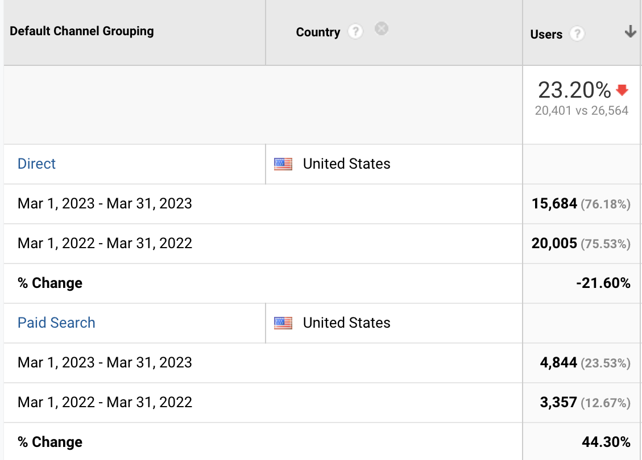
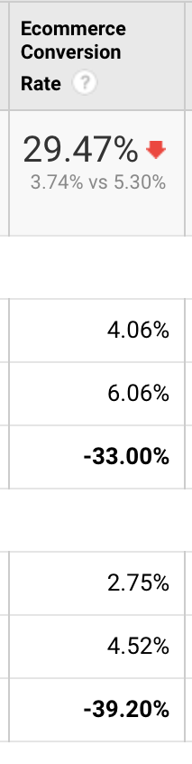
Conversion Rate
Conversion rate has gone down by 29.47% in 2023.
A further breakdown reveals that direct search, which accounts for most visits has seen less decline in conversion rate compared to paid search

Slide 11
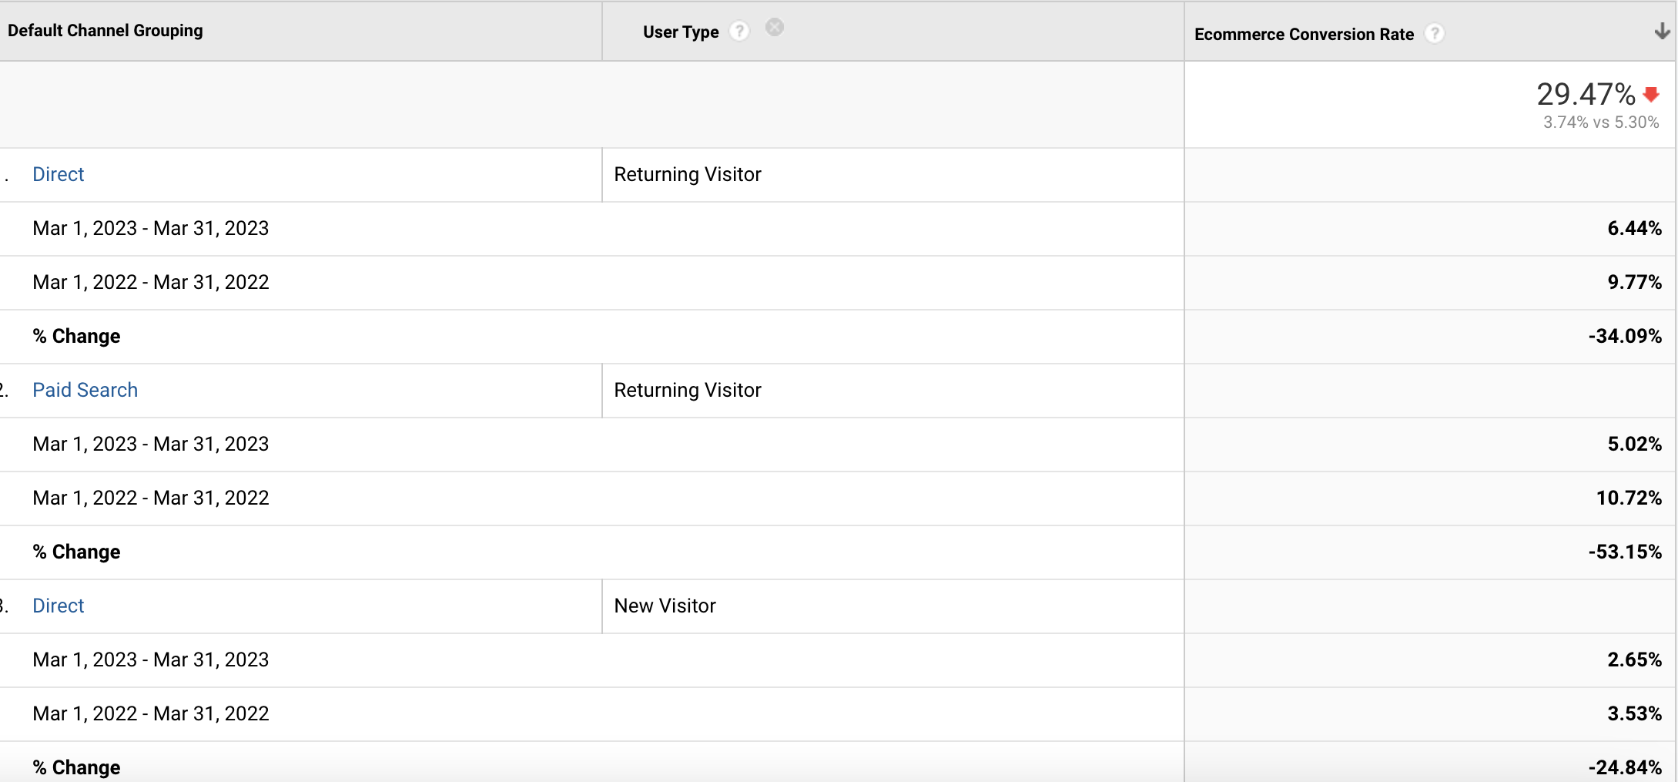
Conversion Rate

Slide 12
Recommendations
Increased user convenience: By making the checkout process as easy and seamless as possible with reduced
number of steps required to complete a purchase; it can be possible to increase the degree of user friendliness
Adding Incentives: Coupons or discounts can be offered to customers who abandon their carts, to encourage them to return and complete the purchase
Enhanced lead generation: Customer reviews and ratings can be used to show social proof and build trust with potential customers. Detailed breakdown about shipping and return policies can also be provided to reduce uncertainty and build trust
Retargeted campaigns: Social media retargeting ads can be used to reach customers who have visited the website but did not make a purchase. Abandoned cart emails can be sent to customers who leave items in their cart but do not complete the checkout process.

Slide 13
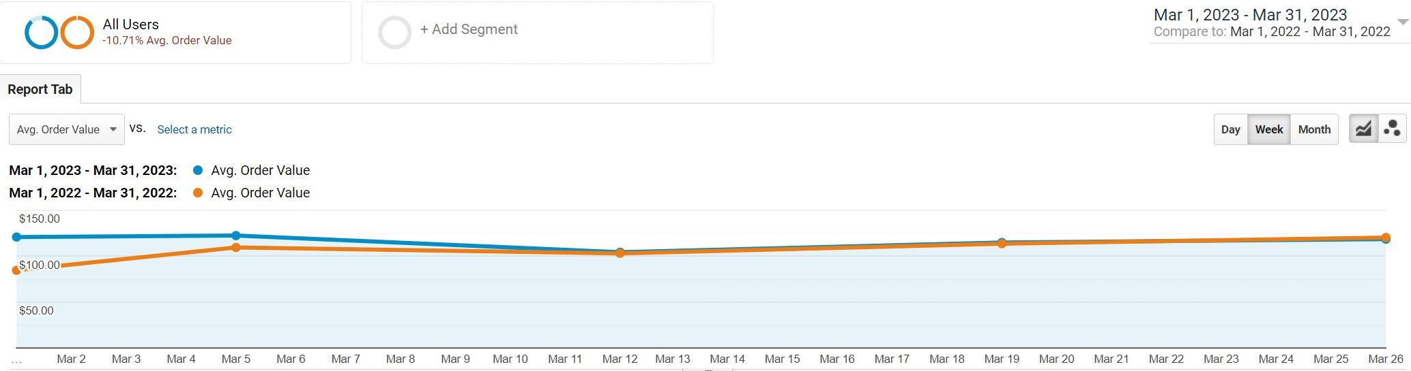
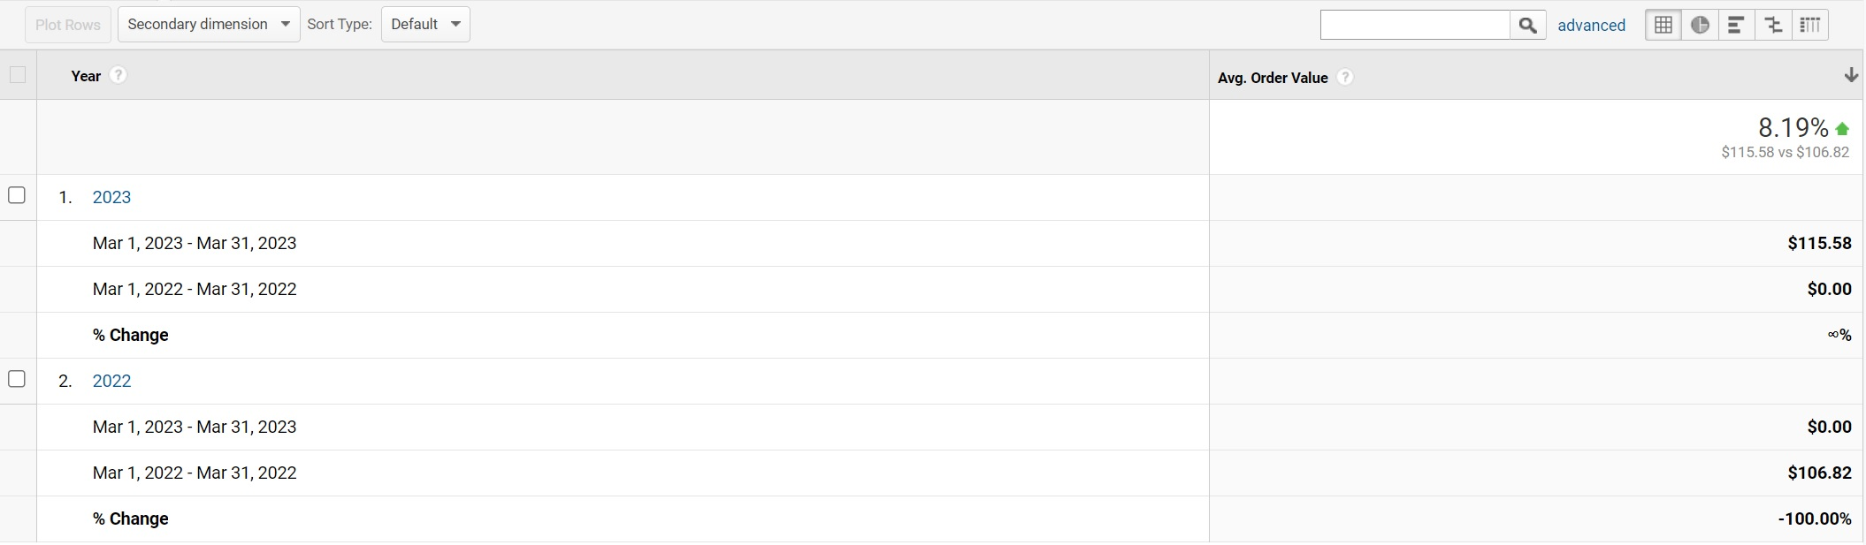
Average Order Value
Average Order Value has gone up by 8.19% compared to March 2023. Even though it seemed like the AOV was dropping in the second week of March 2023, it ultimately stays a little higher at $115.

Slide 14
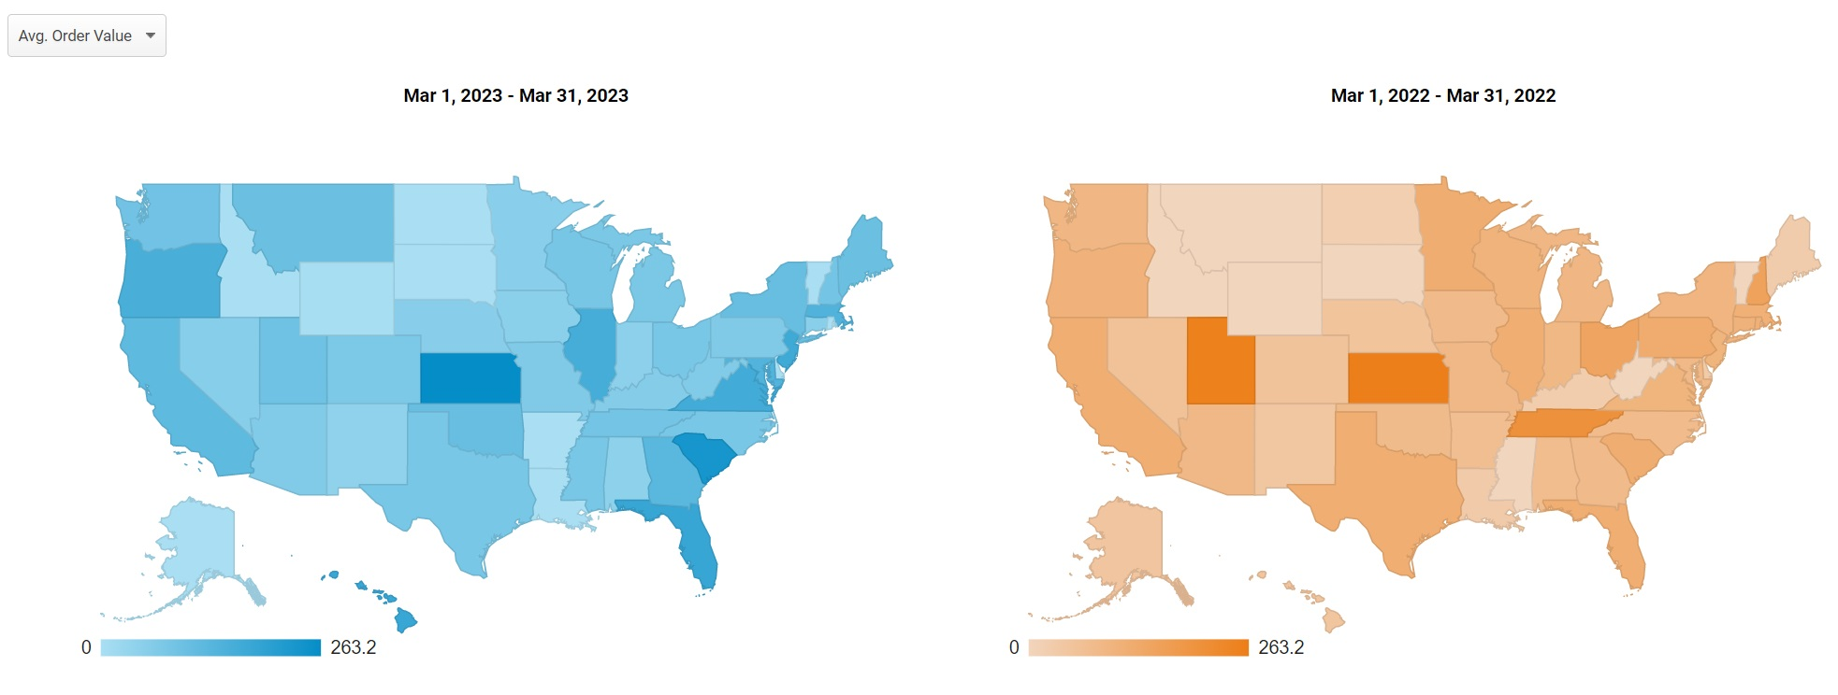
Average Order Value
REGION | AOV 2022 | AOV 2023 | % CHANGE
TEXAS | $118.39 | $78.12 | -34.02%
FLORIDA | $118.31 | $182.80 | 54.51%
NEW JERSEY | $100.70 | $170.49 | 69.31%
PENNSYLVANIA | $124.94 | $67.34 | -46.10%
OHIO | $145.38 | $78.00 | -46.35%
TENNESSEE | $204.45 | $85.38 | -58.24%
SOUTH CAROLINA | $120.90 | $235.42 | 94.72%
UTAH | $255.35 | $94.67 | -62.92%
NEW HAMPSHIRE | $154.73 | $85.60 | -44.68%
HAWAII | $48.75 | $180.00 | 269.23%
Alarming drops in: Texas, Pennsylvania, Ohio, Tennessee, Utah, New Hampshire
Notable increase in: Florida, New Jersey, South Carolina and Hawaii

Slide 15
Recommendations
Offer Product Bundles: Creating product bundles can encourage customers to buy more items at once and increase the AOV. Bundling complementary products that customers typically purchase together and offering a discounted price for the bundle.
Upsell and Cross-Sell: Suggesting complementary products or upgrades to customers during the checkout process or on product pages. For example, if a customer is buying a camera, suggest a camera bag or additional lenses to go with it.
Implement a Loyalty Program: Rewarding customers for spending more with a loyalty program. Offering discounts, free items, or exclusive access to products for customers who reach certain spending thresholds.

Slide 16
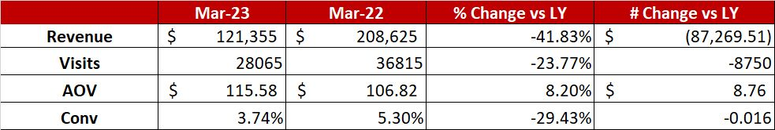
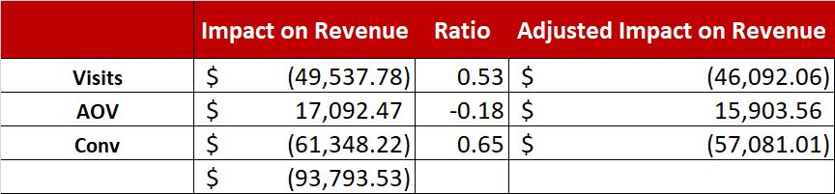
Waterfall Table
Decrease in conversion rate has been the biggest driver of decrease in revenue with an adjusted impact of approximately ($57k)
Increase in AOV had a positive impact on revenue with adjusted impact of approximately $15k
Decrease in number of visits had a negative impact on revenue with adjusted impact of approximately ($46k)

Slide 17


Thanks!

